Slide 1
Web-Based Database and SMS to Facilitate Healthcare Medical Emergency

Slide 2
INDEX
Abstract
Introduction
Literature review
Existing Method
Drawbacks
Proposed method
Advantages
Block Diagram
Implementation
Hardware and Software Requirements

Slide 3
ABSTRACT
Healthcare and medical emergency are essential systems in human life; so that many countries work toward having it. Investigation of Malaysian case shows that it suffer from locality, missing of unified electronic medical record EMR and lack of utilizing Internet, multimedia, wireless and real time technologies.
This leads to difficulty in communication, hard to manage and exchange patient data between various medical units. The fully computerizing and combining of such medical systems will lead to produce a Novel Integrated Healthcare Medical Emergency Model (IHMEM). IHMEM involves web-based database, intelligent agent and sms facility where an agent can give reply to patients about their need. All hospitals, healthcare and emergency centers can view the patient record simultaneously, exchanging, managing and collaborate on sharing resources between medical units.

Slide 4
INTRODUCTION
Many hospitals and emergency centers are not efficient enough because the big number of emergency cases, which is not easy to be handled. In an emergency department, most likely a nurse will determine the severity of the wound and check patient’s vital signs such as temperature, blood pressure and heart rate. Additional personal information and medical history have to be obtained. In case patient’s information is stored in another clinic or hospital they have to be obtained. Unless the patient has brought the personal file along, getting the required information will slow down the process. An emergency physician will have to examine the patient. In some cases, the patient needs great attention and sometimes the surgery room or other devices will be needed. All these will have to be arranged in timely manner, which in general is not the case.

Slide 5
LITERATURE REVIEW
S. NO | Application Type with year | Authors | Title | Outcomes
1 | Report (2006) | Shihab A. Hameed, Shahina Shabnam | Integrated Medical and Emergency System | Unified electronic medical record EMR used in all medical centers.

Slide 6
LITERATURE REVIEW
S. NO | Application Type with year | Authors | Title | Outcomes
2 | Report (2006) | Shihab A. Hameed, Shahina Shabnam | An Intelligent Agent-Based Medication and Emergency System | This project is to develop an intelligent agent-based medication and emergency system

Slide 7
LITERATURE REVIEW
S. NO | Application Type with year | Authors | Title | Outcomes
3 | Report (2006) | Shihab A. Hameed, B.A. Aliyu | WIMAX Wireless Technology to enhance an Integrated Emergency and Guidance System | An integrated emergency and guidance system based on WiMAX was proposes to overcome such problems.

Slide 8
EXISTING SYSTEM
Compared to existing medical related telemedicine application, Telemedicine can be defined as the use of audio, video, and other telecommunications and electronic information processing technologies to provide health services or assist health care personnel at distant sites. However, telemedicine may not suit every person or situation. Protecting medical data in such applications like, Hackers and other criminals may be able to access a patient’s medical data, especially if the patient accesses telemedicine on a public network or via an unencrypted channel.

Slide 9
DISADVANTAGES
Accessing telemedicine may delay treatment.
Hackers may access patient’s medical data.
An inability to examine patients

Slide 10
PROPOSED SYSTEM
In this proposed method, we use the Integrated Healthcare Medical Emergency Model, which can provide stakeholders with related medical information. The registered users can logon to the system and they can search nearby medical centers which provide all hospital information with emergency units and the users/patients can simply send an sms to medical center and the medical center can give reply about the information.

Slide 11
ADVANTAGES
Provides all treatment and emergency wards for patients.
Data will be in safe because the sms system here is a protected and it only operated by one agent/medical centers.
Gives suggestions for good health

Slide 12
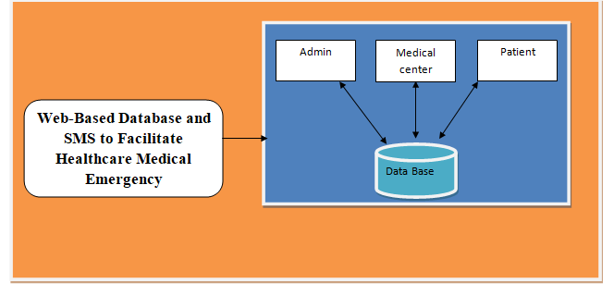
Block Diagram

Slide 13
Modules
Admin : Admin login with valid credentials.
After Logging, the admin has to accept the new registered medical centers.
The Admin can view the medical center and Patient Details.
Medical Center:
Medical Center can register by entering all the details. And login with valid credentials.
After Logging , Medical center can add about the information of all available emergency units .health care can View the profile, and add update and delete the features..
Patient :
Initially Register, and login with valid credentials.
After Logging , the patient can view the profile . Patient can search for medical center and can send sms to them for emergency unit.

Slide 14
SYSTEM REQUIREMENTS
Software Requirements
Operating System : Windows 7+
Application Server : Tomcat 7.0
Front End : HTML, JSP,CSS
Scripts : JavaScript.
Backend Language : Java
Database : MySQL 6.0
IDE : Eclipse(2019-3)

Slide 15
SYSTEM REQUIREMENTS
Hardware Requirements
Processor - Intel i3
RAM - 4GB
Hard Disk - 500 GB

